Slide 1
History

Slide 2

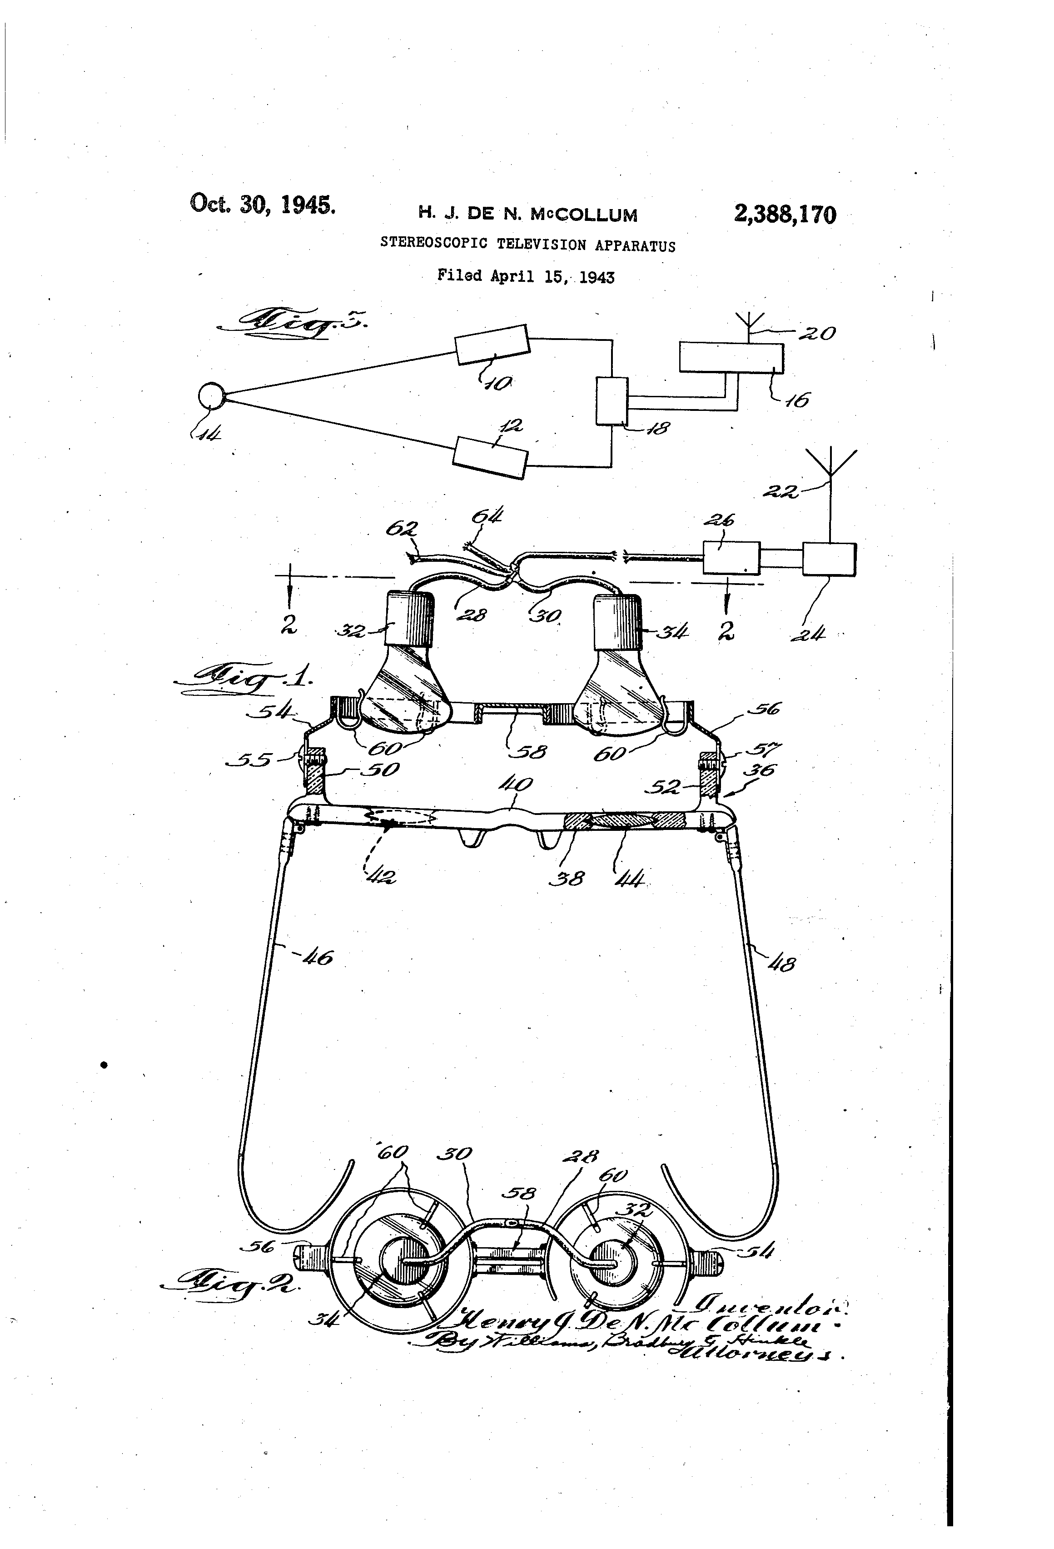
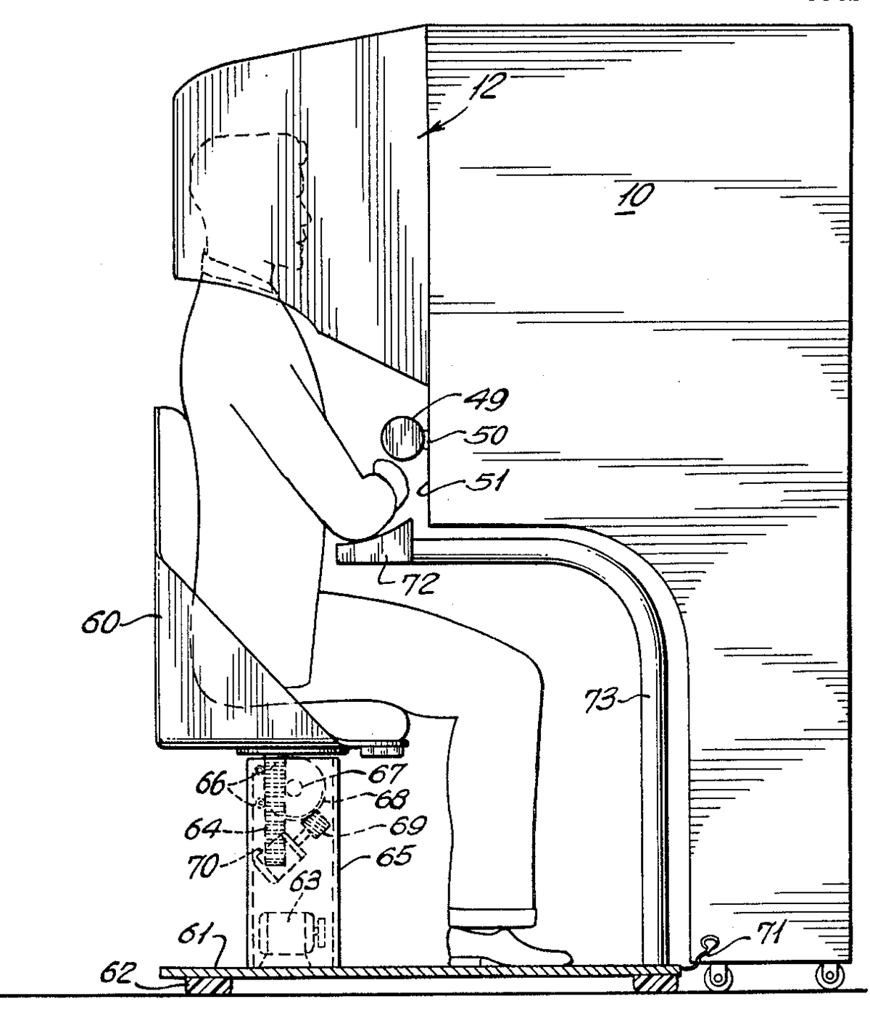
1930s - Stanley G. Weinbaum
First proposed the idea of VR
1955 – Morton Heilig
Envisioned multi-sensory theatre
1960 – Morton Heilig
Patented design for first head mounted display

Slide 3
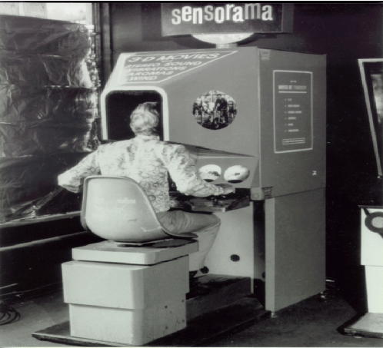
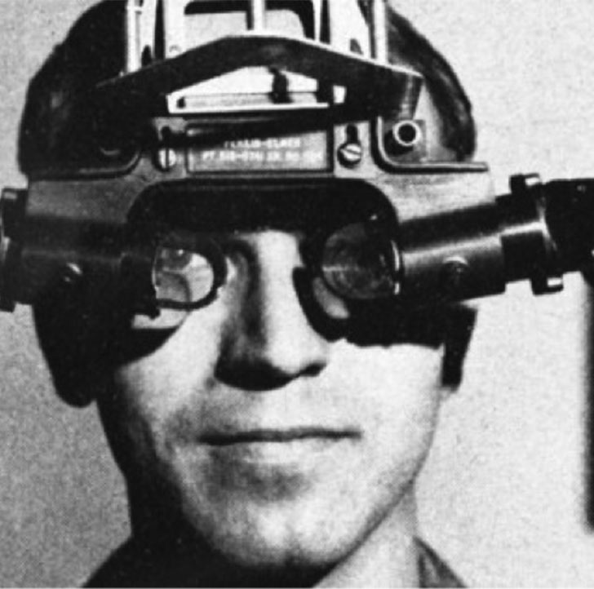
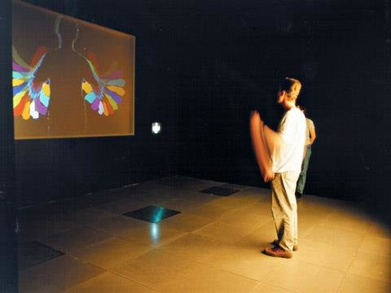
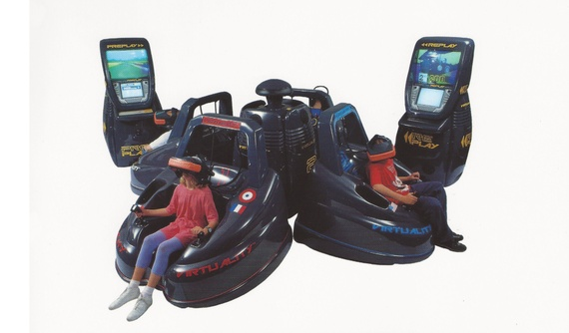
1962 – Morton Heilig
Created Sensorama
1965 – Ivan Sutherland
The Ultimate display
1970s – Myron Krueger
Created VideoPlace
1991 – Virtual Group
Vr arcade games

Slide 4
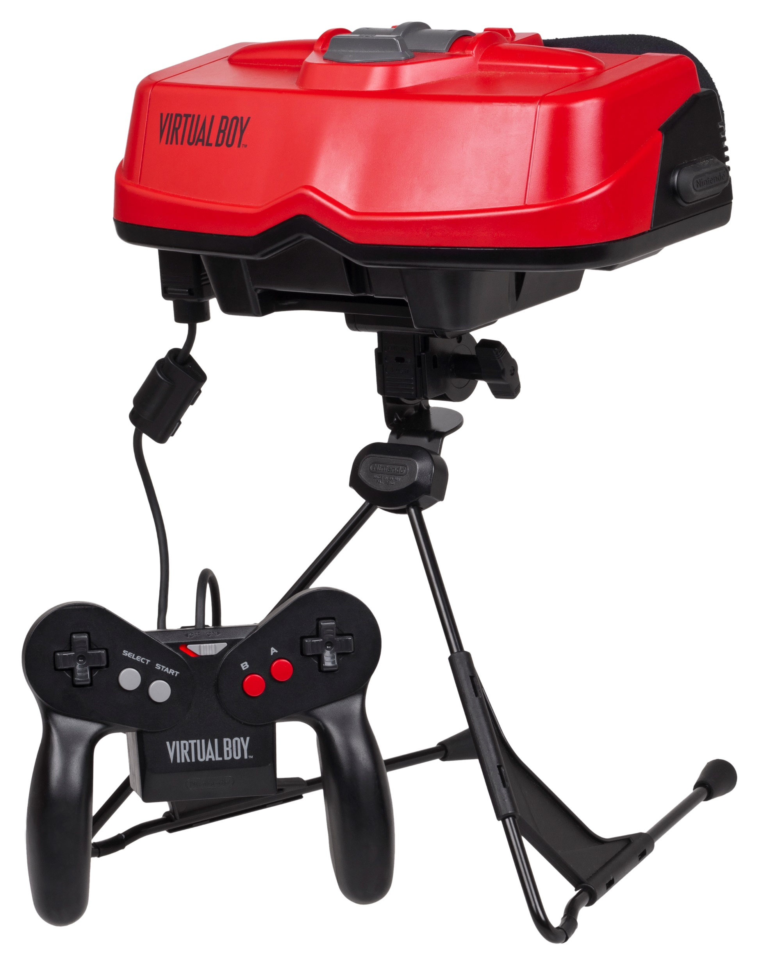

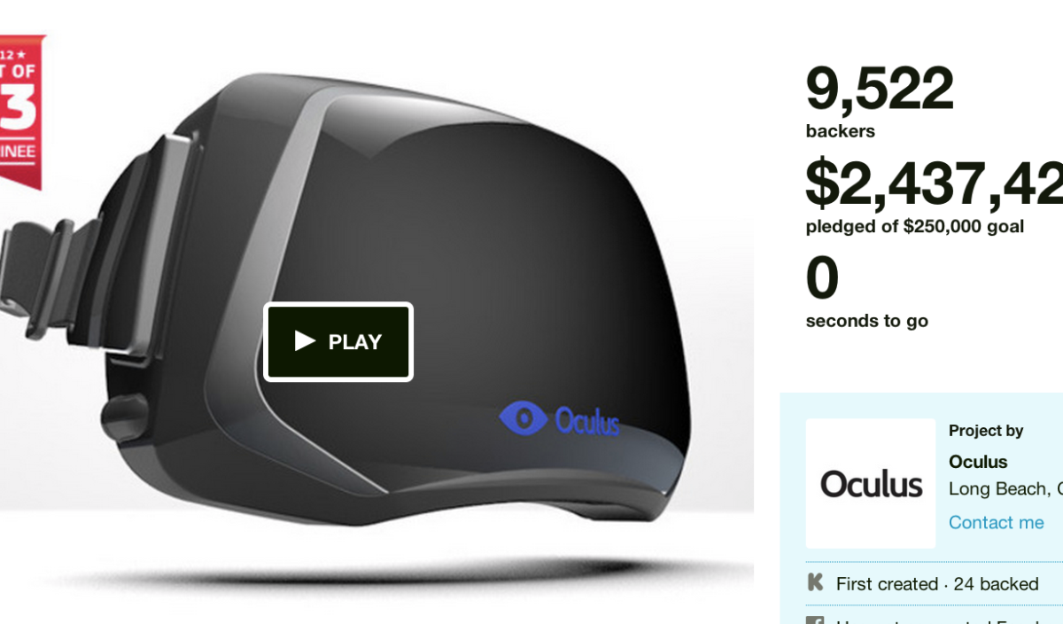
1995 – Nintendo Visual Boy
Head mounted dispay
1999 – The Matrix
Inspired many to invest in VR
2012 - Oculus

Slide 5
Future

Slide 6
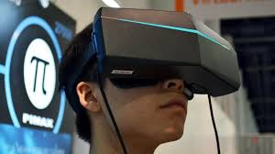
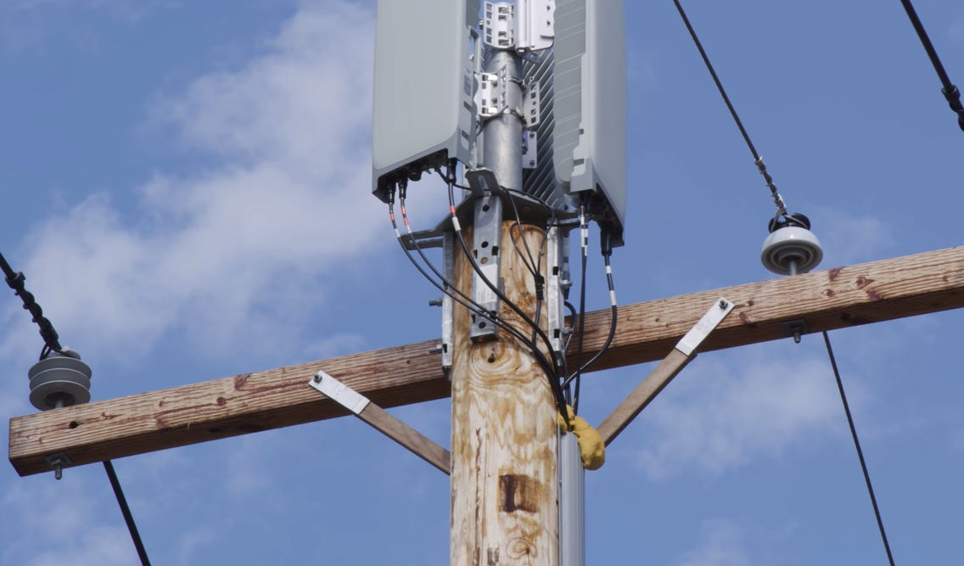
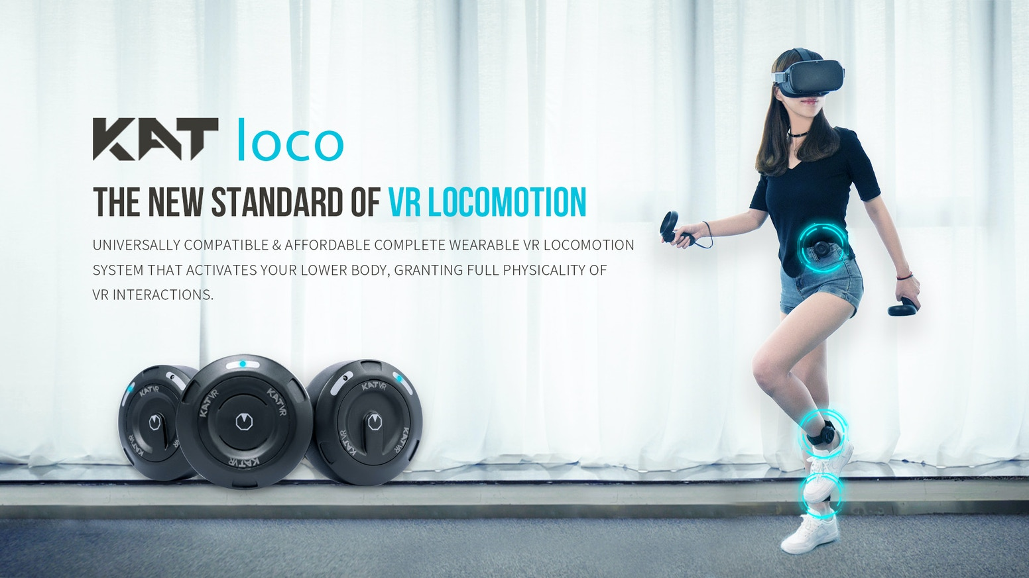
Pimax 8k Headset
Provides a more captivating experience, but requires a very powerful processor.
Development in 5G
VR could potentially receive images in real time
KAT VR
Complete control over lower body

Slide 7
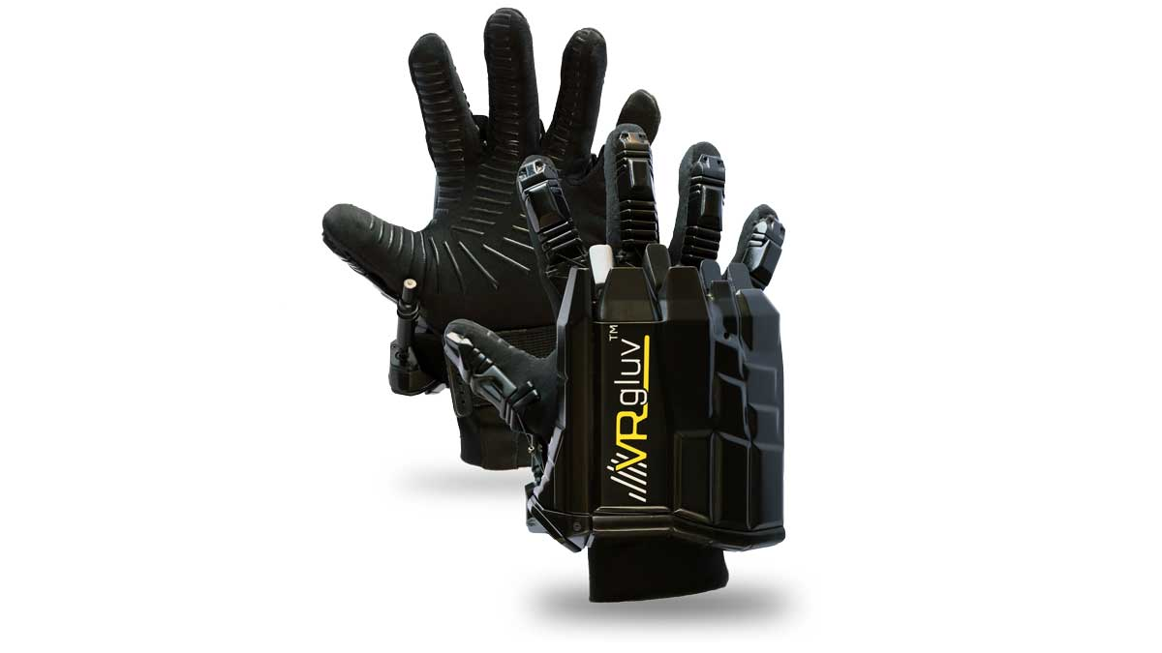
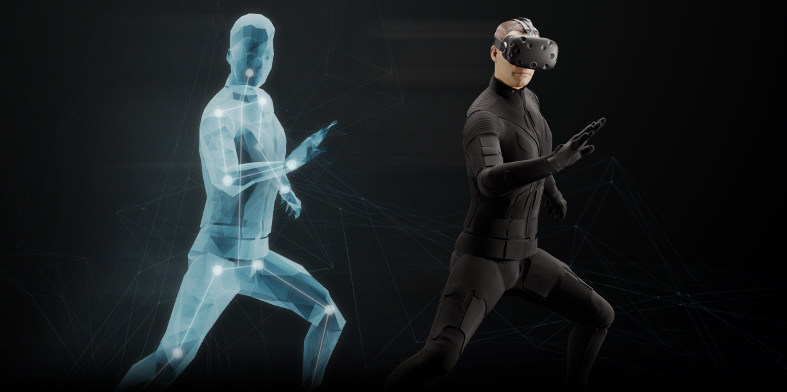
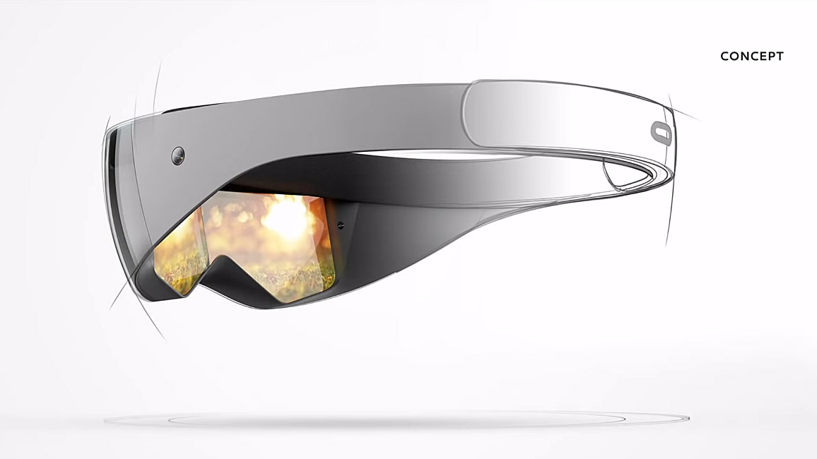
Vr Gluv
Haptic gloves
Tesla Suit
Full body haptic suit, not easily available to the public yet
Future VR headset
It is hoped that VR headsets will be light and easy to ignore when wearing them.

Slide 8
Images Used
Stanley G. Weinbaum https://www.google.com/search?q=pygmalion%E2%80%99s+spectacles&sxsrf=ALeKk01a7pK4HXBOPvXfA8Zg3AfkuyJv_w:1589123546381&source=lnms&tbm=isch&sa=X&ved=2ahUKEwiT1fHDyqnpAhV2VRUIHZesCyIQ_AUoAXoECBoQAw&biw=958&bih=959#imgrc=YsNnQfLHxsEwhM
Sensorama https://www.google.com/search?q=sensorama&sxsrf=ALeKk00COv-TSxlnbRj6Gt7RUQLmj-p6lA:1589123753305&source=lnms&tbm=isch&sa=X&ved=2ahUKEwi7isemy6npAhWBtXEKHQF3AFYQ_AUoAXoECBIQAw&biw=958&bih=910#imgrc=w6G4qZJxxiAuWM
https://www.google.com/search?q=sensorama&sxsrf=ALeKk00COv-TSxlnbRj6Gt7RUQLmj-p6lA:1589123753305&source=lnms&tbm=isch&sa=X&ved=2ahUKEwi7isemy6npAhWBtXEKHQF3AFYQ_AUoAXoECBIQAw&biw=958&bih=910#imgrc=2TYTPhQJ-tAl0M
Swords of democles https://www.google.com/search?q=sword+of+damocles+vr+patent+&tbm=isch&ved=2ahUKEwilyvaczqnpAhV_QkEAHedKAZAQ2-cCegQIABAA&oq=sword+of+damocles+vr+patent+&gs_lcp=CgNpbWcQAzoECCMQJzoCCAA6BAgAEB5QoThYtEJgw0RoAHAAeACAAVyIAfkEkgEBOJgBAKABAaoBC2d3cy13aXotaW1n&sclient=img&ei=uh24XqWFGf-EhbIP55WFgAk&bih=910&biw=958#imgrc=pYBClm2IOJ-zAM
the ultimate display https://www.google.com/search?q=the+ultimate+display&tbm=isch&ved=2ahUKEwj3tsuhzqnpAhVCnVwKHbIrCEYQ2-cCegQIABAA&oq=the+ultimate+&gs_lcp=CgNpbWcQARgAMgQIIxAnMgQIIxAnMgIIADICCAAyAggAMgIIADICCAAyAggAMgIIADICCAA6BAgAEEM6BQgAEIMBUPzMBFjD3ARgyegEaABwAHgAgAFiiAHUCJIBAjEzmAEAoAEBqgELZ3dzLXdpei1pbWc&sclient=img&ei=xB24XvfEC8K68gKy16CwBA&bih=910&biw=958#imgrc=ec7RyybZmswVEM
Video Place https://www.google.com/search?q=video+place+myron&hl=en&sxsrf=ALeKk02R-9Yd-kt2oPVb7ImWoVAZ3SFPeQ:1589124890037&source=lnms&tbm=isch&sa=X&ved=2ahUKEwjuzcvEz6npAhU1RBUIHUmPDzIQ_AUoAXoECBAQAw&biw=958&bih=910#imgrc=F5HNjdkDIg8gEM
Virtuality group https://www.google.com/search?q=virtuality+group+arcade+machines&sxsrf=ALeKk01XLBVjEy_W1w2zfJ1zkiVIfhWI7Q:1589125068947&source=lnms&tbm=isch&sa=X&ved=2ahUKEwiQtvOZ0KnpAhVoQxUIHY_BC-QQ_AUoAXoECBIQAw&biw=958&bih=910#imgrc=NKa14-O7DZRuaM
virtual boy https://www.google.com/search?q=virtual+boy&sxsrf=ALeKk00rbQoF5gFOu86C7gRWiMY68wIWPA:1589125161004&source=lnms&tbm=isch&sa=X&ved=2ahUKEwitoubF0KnpAhU2QRUIHbk0BicQ_AUoAXoECA4QAw&biw=958&bih=910#imgrc=TC2kVlkOpi0WWM
the matrix https://www.google.com/search?q=matrix&sxsrf=ALeKk03VAZ7W06kzZDgaGOInxw1t81XPJQ:1589125292296&source=lnms&tbm=isch&sa=X&ved=2ahUKEwiyzLOE0anpAhWuZxUIHZIqB3EQ_AUoAXoECCcQAw&biw=958&bih=910#imgrc=azv96f54k_36VM
Oculus https://www.google.com/search?q=oculus+2012+kickstarer&tbm=isch&ved=2ahUKEwiY1pfA0anpAhUEQRUIHbOOC8QQ2-cCegQIABAA&oq=oculus+2012+kickstarer&gs_lcp=CgNpbWcQAzoECAAQHjoGCAAQCBAeUNyAAVizlAFgjJUBaABwAHgAgAFsiAG5B5IBBDEwLjGYAQCgAQGqAQtnd3Mtd2l6LWltZw&sclient=img&ei=KSG4XtidKISC1fAPs52uoAw&bih=910&biw=958#imgrc=q9k5Jw2ub6bx9M
Pimax 8k https://www.google.com/search?q=pimax+8k+headset&tbm=isch&sxsrf=ALeKk02cLb3vIVtB7LvpSIvRhejJBFVl-Q:1589207163660&source=lnms&sa=X&ved=0ahUKEwiDm9uDgqzpAhWRVBUIHba5BJ4Q_AUIECgD&biw=1920&bih=969&dpr=1#imgrc=Bs_nHV3mu84G-M
5g https://www.google.com/search?q=5g+tower&tbm=isch&ved=2ahUKEwje-pG9gqzpAhVUQ8AKHR6lD7YQ2-cCegQIABAA&oq=5g+tower&gs_lcp=CgNpbWcQAzIECAAQQzIECAAQQzIECAAQQzIECAAQQzIECAAQQzIECAAQQzIECAAQQzICCAAyAggAMgQIABBDUKIJWMISYM0TaABwAHgAgAHpAYgB9gSSAQUxLjIuMZgBAKABAaoBC2d3cy13aXotaW1n&sclient=img&ei=9GC5Xt6wBdSGgQaeyr6wCw&bih=920&biw=1920#imgrc=_nnozgqVMrIvkM
kat loco https://www.google.com/search?q=kat+loco&hl=en&sxsrf=ALeKk01GGkO6oS8DhAGDRfIvsDwBZ3hZmw:1589207411900&source=lnms&tbm=isch&sa=X&ved=2ahUKEwjcwYr6gqzpAhUSsHEKHeKzCP8Q_AUoAXoECAoQAw&biw=1920&bih=920#imgrc=tEUjJm5KqDxQFM
vr gluv https://www.google.com/search?q=vrgluv&sxsrf=ALeKk00RVQDmHR3GgrdLD0mEgl8m48__UQ:1589207494330&source=lnms&tbm=isch&sa=X&ved=2ahUKEwiI0bGhg6zpAhVeQhUIHTegBsIQ_AUoAXoECAwQAw&biw=1920&bih=920#imgrc=8NGXBBoK53CbrM
tesla suit https://www.google.com/search?q=tesla+suit&sxsrf=ALeKk02_0p51xDq1wXZ3M-J24T5OYUVd9A:1589207585925&source=lnms&tbm=isch&sa=X&ved=2ahUKEwjQlYjNg6zpAhWTUBUIHT8nB7EQ_AUoAXoECAoQAw&biw=1920&bih=920#imgrc=MiEK-Fq4lk31LM
future vr headsets https://www.google.com/search?q=future+vr+headset&sxsrf=ALeKk01zQzHuVstWYecCfQJWkAVMvVejlw:1589207913934&source=lnms&tbm=isch&sa=X&ved=2ahUKEwimnrzphKzpAhU3QxUIHRe4Cb8Q_AUoAXoECBIQAw&biw=1920&bih=920#imgrc=dXg4jlhLRxZTqM
ready player one https://www.google.com/search?q=ready+player+one+real+world&tbm=isch&ved=2ahUKEwjB9eqYhazpAhVeXRUIHRRgAdcQ2-cCegQIABAA&oq=ready+player+one+real+world&gs_lcp=CgNpbWcQAzICCAAyBAgAEBg6BAgjECc6BQgAEIMBOgQIABBDOgcIIxDqAhAnOgYIABAFEB46BggAEAgQHjoECAAQHlDWwAFYy_YBYIL4AWgHcAB4AIAB8QKIAeUhkgEJMTYuMTQuMi4ymAEAoAEBqgELZ3dzLXdpei1pbWewAQo&sclient=img&ei=zWO5XoHbD9661fAPlMCFuA0&bih=920&biw=1920#imgrc=Gdy_I10bpQxf6M

